Slide 1
Orientation Workshop for Course Coordinators
What is MOOCs including
UGC Regulations & its Adoption.
Dr (Mrs) Pankaj Mittal
Additional Secretary, UGC
(Former Vice Chancellor,
BPS Women University)
May 10th, 2018

Slide 2

Information flow and Media Consumption Habits

Slide 3










E-content development under E-PGP
Developing e-content in 77 subjects
Team-work
1 Subject = 16 Paper*
1 Paper = 30-35 Module (20 Hr lecture)
Total module = 16 X 35 = 560
Principal Investigator
(1)
Pool of CR/LE
Paper Coordinator
(16)
CR
Four Quadrant approach
LE
Each Module comprises of
e-text = textual material
Self- learning = audio / video component
Self assessment = Questions
Learn More = further reference material
Team of Authors/
Content Writers
* 4 core paper of each semester (2Yr course)

Slide 4


Present Status of e-PG Pathshala
Videos/e-text available on e-PG Pathshala web
20,000+
Visitors on e-PG Pathshala (Globally)
34 lakh+
E-content of e-PG Pathshala used for developing MOOCs on SWAYAM and for telecasting videos on 10 DTH Channels under Swayam Prabha project

Slide 5
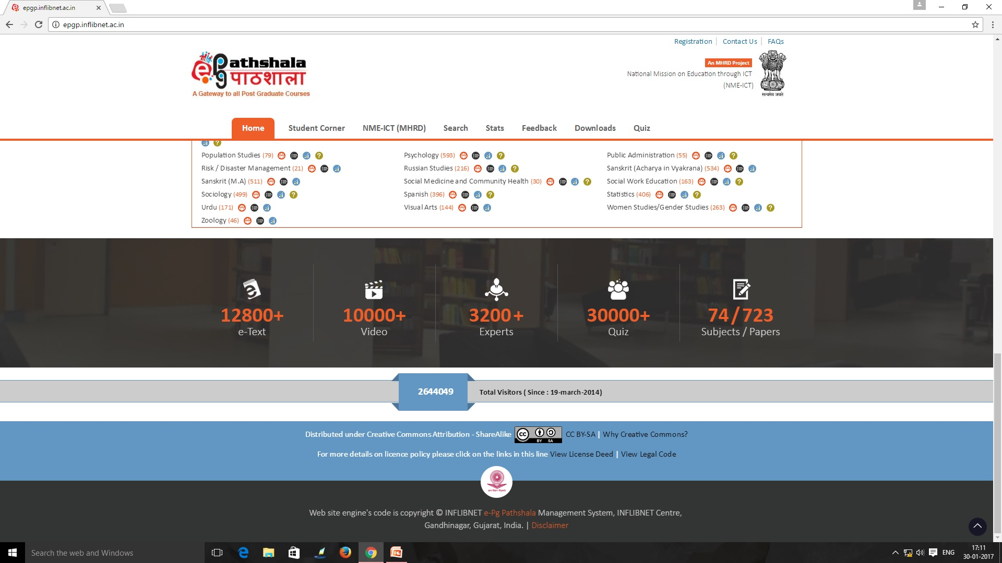
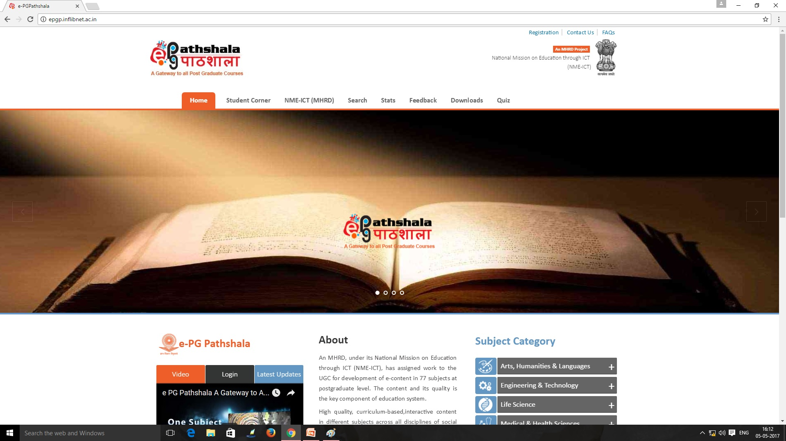

Slide 6
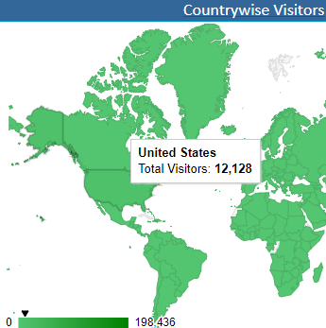
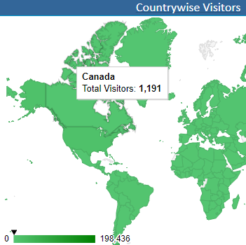
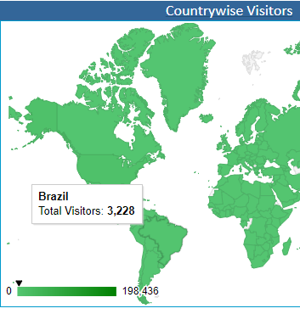
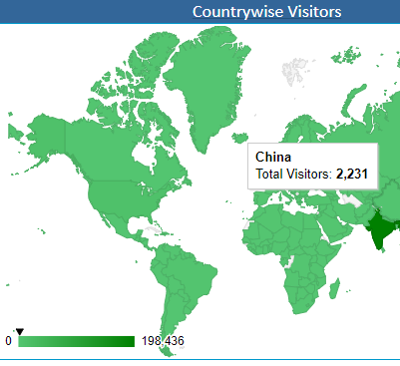
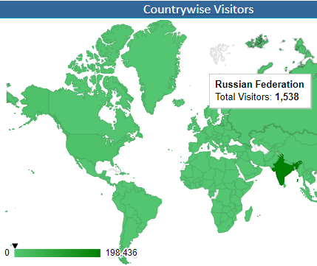
Impact Analysis of e-PG Pathshala
e- Content is available in open access at www.epgp.inflibnet.ac.in
International visitors – 12128+ from USA, 3228+ from Brazil, 2231+from China, 1191+ from Canada and 1538+ from Russian federation)
Total visitors - 33.63lakh (as on 15th January, 2018)

Slide 7
MOOCs - A different educational space
Boundary less Institute / University
Massive – Large enrolment numbers
Open - No mandatory qualifications – Open to all
Online – Fully online
Course - Structured course content
is an online course aimed at unlimited participation and open access via the web.
The basic philosophy of MOOCs is 3A’s i.e., Anytime, Anyone, Anywhere.

Slide 8
NATIONAL COORDINATORS
National MOOCs Coordinator | Sectors
University Grants Commission (UGC) | Non-Technology Post Graduate Degree Programs
NPTEL | Technical/Engineering UG & PG degree programs
Consortium for Educational Communication (An IUC of UGC) | Non-Technology Under Graduate degree programs.
IGNOU | Diplomas and Certificates
NCERT | School Education from Class 9th to 12th.
NIOS | School Education from Class 9th to 12th.
IIM Bangalore | Management programs.
NITTR, Chennai | Teacher Training programs.

Slide 9
Difference between e-content and MOOCs
E-PG Pathshala
(OER)
MOOCs
MOOCs has teacher-student groups where MOOC coordinator/teacher interacts with the learner. A learner can earn certificate/credit on successful completion of MOOCs course on SWAYAM.
E-PG Pathshala provides e-content in four quadrants. It can be accessed as Open Educational Resource (OER) where no teacher support/hand-holding for students is available.

Slide 10
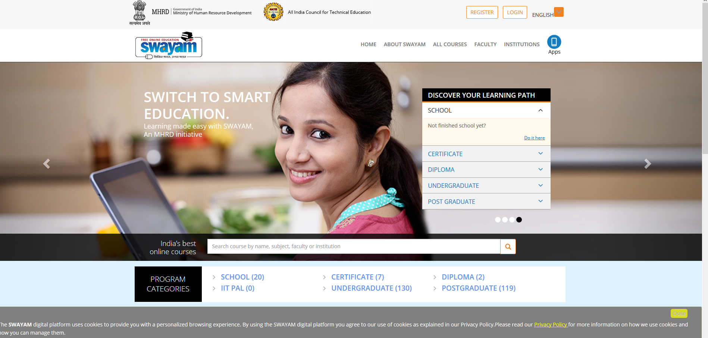

Slide 11


Making and Hosting of MOOCs Courses
Multimedia Team for video recording, slides, Animations
UGC/CEC to
identify Course Coordinator and
Host Institutes
Course Coordinator to identify Content writers/Reviewers / Language Editors/Video presenters
Develop Courses and host on
SWAYAM Portal

Slide 12
MOOCs development under SWAYAM
Developing MOOCs
Team-work
1 Course = 1 Paper ( content to be spread over 15 weeks, comprising of about 40 hours of learning for a 4 credit course)
Course Coordinator
Pool of CR/LE
Each week to have
e-text (slides/written text)
Audio / Videos (each video to be of 10-12 minutes duration) (Video duration for the entire course to be about 20 hours)
Assignments ( 2 -3 in the entire course)
Self assessment Questions
Discussion Forums
Quizzes (2-3 in the course)
Activities
References (video/ web links)
Content writer
CR
LE
Team of Video presenters/
Multimedia

Slide 13
Structure of the MOOCs Course
Course introductory video :- 5 minute duration(Covers Course objectives, description, structure & brief about course content / curriculum , pre-requisites & learning outcomes of the course)
Week Introductory Videos( 15) :- 1-2 minutes video covers the week-wise description & brief content and activities to be undertaken in the week.
Week Content (15) : Will include the course content in forms of texts & videos, self-assessment questions, activities, discussion forums & refrences.
Week sum-up videos (15) :- 1-2 minutes summing up video covers the content taught in the week.
Quizzes & Assignments (2-3 in a course)
Assessment Plan :- Grading Scheme: Allocation of marks (in percentage) to Assignments, quizzes, and Final Examination.

Slide 14
Life Cycle of A MOOCs Course
01
02
033
04
Course proposal and approval
Content Development
&
Repurpose (if required)
Consent from University (for credit)
Course Announcement, Content uploading , Student Enrolment
08
05
06
07
Student Activity and Interact with student through forum and chat
Proctored Examination
Certification and Credit Transfer from the host institute
Course Delivery

Slide 15
Repurposing Content
Requirement
Action Plan
Work on existing content developed under e-PG Pathshala
Examine existing content with respect to four quadrants. Coverage of all topics for a given course in four quadrants. Supplement existing materials with transcriptions of video, incorporation of multimedia, if required. Add introductory & sum-up video for the course and for each week.

Slide 16
Repurposing Content
Requirement
Action Plan
Course Plan (week-wise) can be developed by sequentially arranging the 40 modules for each paper of e-PGPathshala in a sequential manner. After this, 2-3 modules need to be clubbed spanning the distribution across 13-15 weeks as “WEEK-1”, WEEK-2”, WEEK-3” and so on. An appropriate title reflecting the topics contained in the modules scheduled in the same week need to be provided.
Sequencing and chunking

Slide 17



UGC (Credit Framework for Online Learning Courses through SWAYAM) Regulation, 2016
Issued on 19th July 2016
Learning Courses
Notification
Online learning courses to be available on SWAYAM
SWAYAM to notify courses on June 1 & Nov 1, every year
Credit Transfer
Choice of Courses
Up to 20% courses in a Program can be on SWAYAM
Courses on SWAYAM permitted for credit transfer

Slide 18




Step by step procedure to be adopted by Universities for adopting MOOCs on SWAYAM
Step-1: Make Amendments
Step-2: Select the Courses
The University through their Competent Authority (EC, AC, BOS), should make amendments in their Ordinances, Rules, Regulations to incorporate provisions for transfer of credits for MOOCs courses as per UGC Regulations.
The University shall select the courses to be permitted for credit transfer through SWAYAM. (eg courses in high demand for which faculty is not available, elective courses or for supplementing teaching-learning process) while ensuring that physical facilities like laboratories, computer facilities, library etc. required for the course are made available free to the students in adequate measure.
Step-3: Designate Course Coordinator
The University must designate a Course Coordinator/facilitator to guide the students throughout the course and to facilitate/conduct the Lab/Practical sessions/examinations.
Step-4: Disseminate Information
The University should widely disseminate information about selected courses to the students through faculty members, notice boards, student forums, workshops and university website etc.

Slide 19




Steps Continued…
Step-5: Course Registration
University to facilitate registration of students. Every student enrolled for the course in the University must register for the MOOCs course.
Step-6: Evaluation
The Host Institution shall evaluate the students registered for MOOCs courses based on discussion forums, quizzes, assignments, sessional and final examinations. The University to assist Host Institution in conducting the final examination.
Step-7: Marks of the Students
The University shall incorporate the marks/grades communicated by the Host Institution in the final mark sheet of the student which counts for award of degree/diploma. However, the University shall evaluate the students for the practical/lab component and incorporate these marks/grades in the overall mark sheet of the student.
Step-8: Certificate
On receipt of MOOCs completion certificate from Host Instt, the University to give equivalent credit weightage upto 20% for the credits earned through SWAYAM. No University shall refuse any student for credit mobility for courses earned through MOOCs.

Slide 20
Expectations from New Course Coordinators
Prepare one week Course content consisting of introductory video of 5 minute duration, e-text, videos, self-assessment questions, references, discussion forum for one week and submit to UGC by email to econtent.ugc@gmail.com latest by 31st May,2018.
Rs 1.35 lacs( 10% of the MOOCs cost) will be released to your institution within a week.
Be prepared for a presentation to UGC in first half of June,2018
On approval of one week content, “Go Ahead” will be given for developing the complete course.
Repurposed
Promote the SWAYAM MOOCs developed by you through Twitter, Face book, Whatsapp and other social media.
Your course will be offered from July, 2018 for repurposed and January, 2019 for new courses.

Slide 21
Expectations from Course Coordinators of Repurposed MOOCs
Rs 3.00 lacs will be released to your institution within a week (if not released so far).
Revise the MOOCs course as per the new guidelines.
UGC will send the course invite immediately on your request.
Please upload the complete course on the SWAYAM platform latest by 31st May, 2018
Your course will be offered on Swayam from July, 2018
Promote the MOOCs being developed by you through Twitter, Face book, Whatsapp and other social media.

Slide 22
Thanks for patient hearing
All the Best for developing Quality MOOCs.
pankajugc@gmail.com

